Slide 1
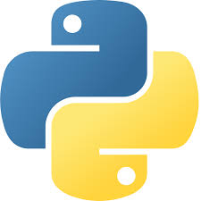


CAP776
PROGRAMMING IN PYTHON
Lecture #0
The Kick Start Session

Slide 2
Course Details
L-T-P :: 3-0-2
[Three Theory and Two Practicals/week]

Slide 3

Revised Bloom’s Taxonomy

Slide 4
Course Outcomes
Through this course students should be able to
CO1 :: define the basic structure and features of Python programming.
CO2 :: understand the working of object-oriented programming concepts like encapsulation, inheritance and polymorphism.
CO3 :: apply pandas and NumPy libraries for data analysis and visualize results using matplotlib and seaborn.
CO4 :: analyze the situation specific problems and perceive solutions.

Slide 5
Program Outcomes
Domain Knowledge: Ability to apply exploration to study and analyze problems in different areas of information technology.
Environment and sustainability: Understand the impact of sciences and computers’ to craft solutions in a global, economic, environmental, and societal context.
Modern tool usage: Ability to use the modern programming languages, tools, techniques and skills necessary for design, develop and deploy software based applications.
Analysis and design of complex problem: Ability to apply knowledge of computer science concepts, principles & techniques to solve various computing
Computational Knowledge: Apply knowledge of computing fundamentals, computing specialisation, mathematics, and domain knowledge appropriate for the computing specialisation to the abstraction and conceptualisation of computing models from defined problems and requirements.
Problem Analysis: Identify, formulate, research literature, and solve complex computing problems reaching substantiated conclusions using fundamental principles of mathematics, computing sciences, and relevant domain disciplines.
Design /Development of Solutions: Design and evaluate solutions for complex computing problems, and design and evaluate systems, components, or processes that meet specified needs with appropriate consideration for public health and safety, cultural, societal, and environmental considerations.
Conduct investigations of complex Computing problems: Use research-based knowledge and research methods including design of experiments, analysis and interpretation of data, and synthesis of the information to provide valid conclusions.

Slide 6
Modern Tool Usage: Create, select, adapt and apply appropriate techniques, resources, and modern computing tools to complex computing activities, with an understanding of the limitations.
Professionl Ethics: Understand and commit to professional ethics and cyber regulations, responsibilities, and norms of professional computing practices.
Life-long Learning: Recognize the need, and have the ability, to engage in independent learning for continual development as a computing professional.
Project management and finance: Demonstrate knowledge and understanding of t h e c o m p u t i n g and management principles and apply these to one’s own work, as a member and leader in a team, to manage projects and in multidisciplinary environments.
Communication Efficacy: Communicate effectively with the computing community, and with society at large, about complex computing activities by being able to comprehend and write effective reports, design documentation, make effective presentations, and give and understand clear instructions.

Slide 7
Societal and Environmental Concern: Understand and assess societal, environmental, health, safety, legal, and cultural issues within local and global contexts, and the consequential responsibilities relevant to professional computing practices.
Individual and Team Work: Function effectively as an individual and as a member or leader in diverse teams and in multidisciplinary environments.
Innovation and Entrepreneurship: Identify a timely opportunity and using innovation to pursue that opportunity to create value and wealth for the betterment of the individual and society at large

Slide 8
CO-PO Mapping
Outcomes | CO1 :: define the basic structure and features of Python programming. | CO2 :: understand the working of object-oriented programming concepts like encapsulation, inheritance and polymorphism. | CO3 :: apply pandas and NumPy libraries for data analysis and visualize results using matplotlib and seaborn. | CO4 :: analyze the situation specific problems and perceive solutions.
Domain Knowledge: Ability to apply exploration to study and analyze problems in different areas of information technology. | 3 | 2 | 2 | 2
Environment and sustainability: Understand the impact of sciences and computers’ to craft solutions in a global, economic, environmental, and societal context. | 1 | 1 | 2 | 2
Modern tool usage: Ability to use the modern programming languages, tools, techniques and skills necessary for design, develop and deploy software based applications. | 2 | 2 | 2 | 2
Analysis and design of complex problem: Ability to apply knowledge of computer science concepts, principles & techniques to solve various computing. | 2 | 2 | 3 | 2
Computational Knowledge: Apply knowledge of computing fundamentals, computing specialization, mathematics, and domain knowledge appropriate for the computing specialization to the abstraction and conceptualization of computing models from defined problems and requirements. | 2 | 2 | 3 | 2

Slide 9
CO-PO Mapping
Outcomes | CO1 :: define the basic structure and features of Python programming. | CO2 :: understand the working of object-oriented programming concepts like encapsulation, inheritance and polymorphism. | CO3 :: apply pandas and NumPy libraries for data analysis and visualize results using matplotlib and seaborn. | CO4 :: analyze the situation specific problems and perceive solutions.
Problem Analysis: Identify, formulate, research literature, and solve complex computing problems reaching substantiated conclusions using fundamental principles of mathematics, computing sciences, and relevant domain disciplines. | 2 | 1 | 3 | 2
Design /Development of Solutions: Design and evaluate solutions for complex computing problems, and design and evaluate systems, components, or processes that meet specified needs with appropriate consideration for public health and safety, cultural, societal, and environmental considerations. | 2 | 2 | 3 | 2
Conduct investigations of complex Computing problems: Use research-based knowledge and research methods including design of experiments, analysis and interpretation of data, and synthesis of the information to provide valid conclusions. | 1 | 2 | 3 | 3
Modern Tool Usage: Create, select, adapt and apply appropriate techniques, resources, and modern computing tools to complex computing activities, with an understanding of the limitations. | 1 | 1 | 3 | 3

Slide 10
CO-PO Mapping
Outcomes | CO1 :: define the basic structure and features of Python programming. | CO2 :: understand the working of object-oriented programming concepts like encapsulation, inheritance and polymorphism. | CO3 :: apply pandas and NumPy libraries for data analysis and visualize results using matplotlib and seaborn. | CO4 :: analyze the situation specific problems and perceive solutions.
Professional Ethics: Understand and commit to professional ethics and cyber regulations, responsibilities, and norms of professional computing practices. | 1 | 1 | 2 | 1
Life-long Learning: Recognize the need, and have the ability, to engage in independent learning for continual development as a computing professional. | 1 | 1 | 1 | 1
Project management and finance: Demonstrate knowledge and understanding of t h e c o m p u t i n g and management principles and apply these to one’s own work, as a member and leader in a team, to manage projects and in multidisciplinary environments. | 1 | 1 | 2 | 1
Communication Efficacy: Communicate effectively with the computing community, and with society at large, about complex computing activities by being able to comprehend and write effective reports, design documentation, make effective presentations, and give and understand clear instructions. | 1 | 1 | 2 | 1

Slide 11
CO-PO Mapping
Outcomes | CO1 :: define the basic structure and features of Python programming. | CO2 :: understand the working of object-oriented programming concepts like encapsulation, inheritance and polymorphism. | CO3 :: apply pandas and NumPy libraries for data analysis and visualize results using matplotlib and seaborn. | CO4 :: analyze the situation specific problems and perceive solutions.
Societal and Environmental Concern: Understand and assess societal, environmental, health, safety, legal, and cultural issues within local and global contexts, and the consequential responsibilities relevant to professional computing practices. |  |  | 1 | 2
Individual and Team Work: Function effectively as an individual and as a member or leader in diverse teams and in multidisciplinary environments. |  |  | 2 | 1
Innovation and Entrepreneurship: Identify a timely opportunity and using innovation to pursue that opportunity to create value and wealth for the betterment of the individual and society at large. |  |  | 2 | 2

Slide 12

The Hitch…
Three BURNING questions in mind…
Why we are learning Python?
What would we do with it?
What will be the course outcomes?

Slide 13
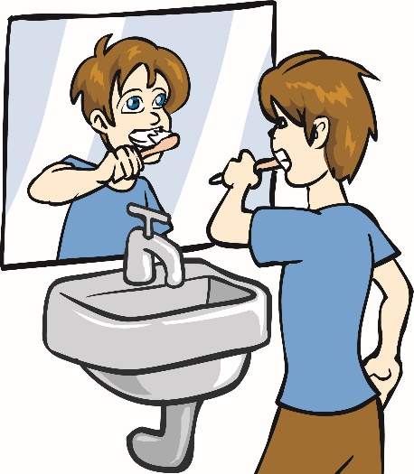
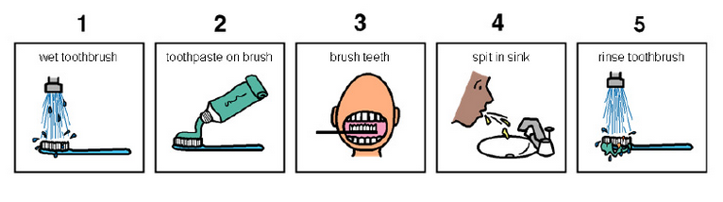
Daily Routine
Let us look around our daily routine…
Let us see where all we do programming everyday
Simple things we do to start the day
So there is ONE program you know which is there in you…

Slide 14

Daily Routine
Start
There is a set procedure
Each step is defined
The occurrence is ordered
Jump is NOT permitted
A step cannot be skipped
Pick Brush
Rinse Brush
Apply Paste
Brush
Rinse Mouth
Rinse Brush
Stop

Slide 15

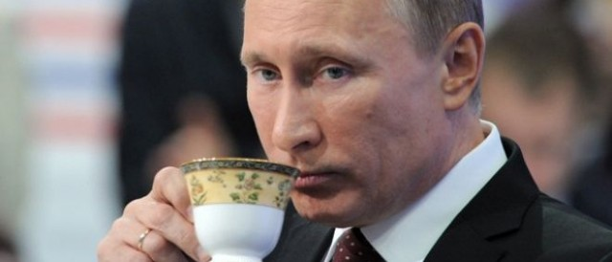




Daily Routine
Yet another example but more complex
Vision
Sensor
Sipping TEA
Smell
Sensor
Radiation
Sensor
If all sensors
SIP
If even one is
Touch
Sensor
WAIT!!!

Slide 16





So what does this mean?
Take ANY activity of the day…
It will have a set procedure
It has to be done in a designated way
If not done the specified way will yield wrong results
Success in doing it depends on how closer one is to the prescribed method
This clearly shows that everything has a

Slide 17


What Next?
There has to be logic machine to assimilate, understand, solve, store, retrieve and represent logic
There has to be a LANGUAGE to communicate with the logic machine
Otherwise….

Slide 18




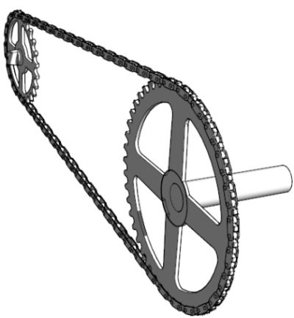
Diving deeper…
How do I become the master of Python?
By working more harder and executing various logics correctly

Slide 19
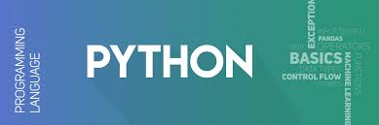
Course Content
Python basic
OOP concepts
Introduction to NumPy
Handling data with pandas
Data visualization
Machine learning

Slide 20
What do we need to know?
Python basic
Introduction
data types and operators
control statements
Functions
Strings
Lists
sets, tuples and dictionaries

Slide 21
What do we need to know?
OOP concepts
OOP features, encapsulation, inheritance
function overloading, operator overloading and method overriding
Exception handling, catching exceptions, catching multiple exceptions
raising exceptions, custom exception

Slide 22
What do we need to know?
Introduction to NumPy
arrays vs lists, array creation routines, arrays from existing data
indexing and slicing, Operations on NumPy arrays, array manipulation
broadcasting, binary operators
NumPy functions:, mathematical functions, statistical functions, sort, search and counting functions

Slide 23
What do we need to know?
Handling data with pandas
introduction to pandas, series, data frame, sorting, working with csv files
operations using data frame
Data cleanup:, investigation, matching and formatting

Slide 24
What do we need to know?
Data visualization
introduction to matplotlib, line plot, multiple subplots in one figure
bar chart, histogram, box and whisker plot, scatter plot, pie charts
introduction to seaborn, seaborn Vs matplotlib, data visualization using seaborn

Slide 25
What do we need to know?
Machine learning
introduction, types of machine learning
linear regression, k-nearest neighbours
decision trees, random forests, k-means clustering

Slide 26
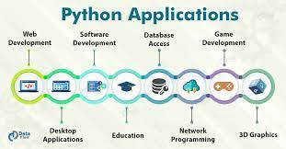
Practical Applications of Python

Slide 27
Course Assessment Model
Marks Break-up
Attendance 5
Continuous Assessment (3 best out of 4) 45
ETP 50
Total 100

Slide 28
Relevant Resources
https://www.w3schools.com/python/
https://docs.python.org/3/tutorial/
https://www.tutorialspoint.com/python3/
https://www.udemy.com/the-ultimate-python-programming-course/

Slide 29
Text Books
“ PROGRAMMING AND PROBLEM SOLVING WITH PYTHON by ASHOK KAMTHANE, AMIT
ASHOK KAMTHANE, M.G.Hills

Slide 30
Reference Books
PYTHON: THE COMPLETE REFERENCE by MARTIN C. BROWN, MC GRAW HILL

Slide 31
Additional : Book
A journey to core Python, By Girish Kumar, Dr. Ajay Shriram Kushwaha : BPB Publication

Slide 32
Imp. Points to keep in Mind
Things to Ensure in True Letter and Spirit:
Join the class on time
RECAP of 2 Minutes on daily basis
Home Exercises
Never skip any CA
No postponement of CA
Quiz Polls in each class

Slide 33

Next Class: Introduction to Python Concepts…
That’s all for this lecture

Slide 34





